Slide 1
Cluster Analysis and Risk Factors to Optimize a Portfolios
Machine Learning in Finance Final Project
Fanhao Kong

Slide 2
Introduction
Importance of portfolio optimization in financial markets.
Use of Fama-French Three-Factor Model for systematic risk analysis.
Integration of clustering and mean-variance optimization (MVO).
Objectives: Improve diversification and enhance portfolio returns.

Slide 3
Workflow
Stock Data
Monthly Returns
Fama French 3 Factors
Risk Exposures with OLS
Regression
Data collection processing
3 Factor exposures
Sharpe Ratio
Information Ratio
Maximum Drawdown
PCA dimensionality reduction
K-means clustering
Compare S&P500, 1/N Portfolio
Mean-Variance Optimization
--Weights

Slide 4
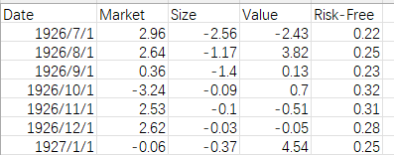
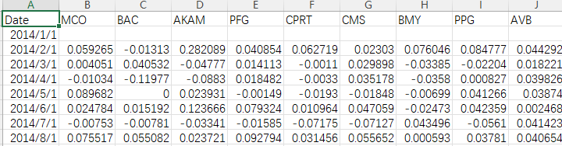
Data Description
Data from S&P 500 Index (2014–2024, monthly frequency).
Random selection of 50 stocks for analysis.
Fama-French 3 factors – Market, Size, Value
S&P 500 as benchmarks.

Slide 5
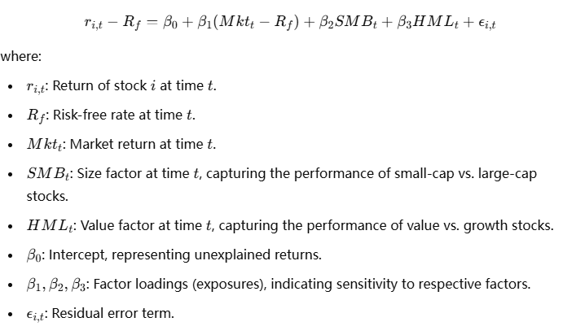
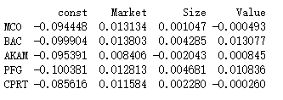
Methodology-Factor Analysis
Calculate Excess Returns (𝑅𝑖−𝑅𝑓) to remove risk-free rate effects.
OLS Regression to estimate factor exposures for each stock.
A high βi, Mkt indicates that the stock is highly correlated with the overall market movements.
A positive βi, Size suggests the stock behaves like a small-cap stock.
A positive βi, Value suggests the stock has value characteristics (high book-to-market ratio).

Slide 6
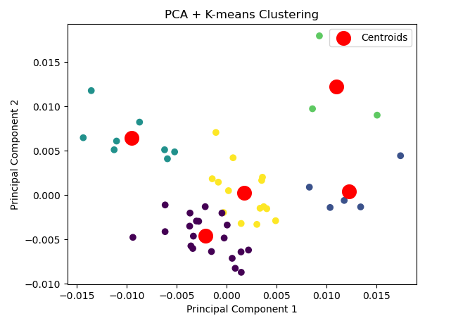
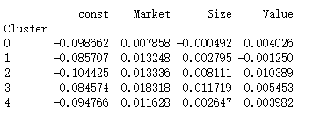
Clustering Analysis
PCA—4dimensions to 2
Explained variance ratio: [0.48888926 0.31910505]
K-means clustering—5 clusters
Not well-separated
Silhouette Score for k=
3: 0.4932754524107065

Slide 7
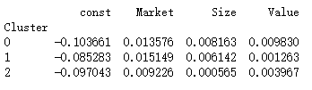
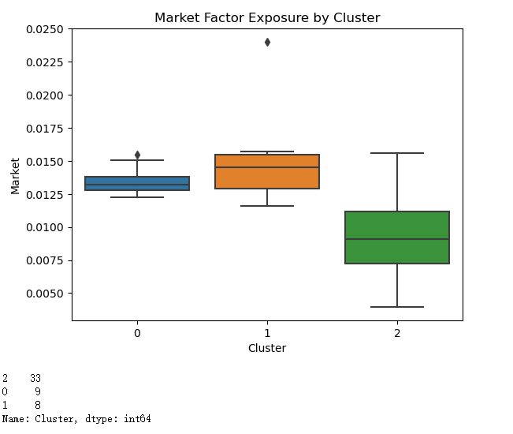
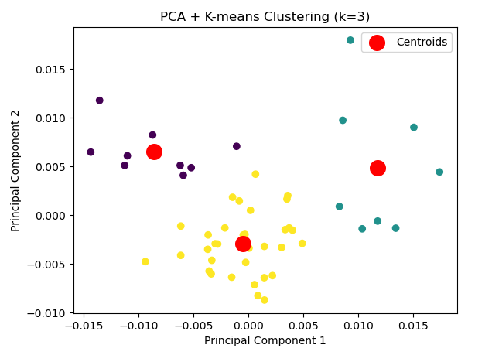
Clustering Analysis
Cluster 0: High-risk small-cap value stocks.
Cluster 1: Large-cap growth stocks.
Cluster 2: Balanced medium-cap stocks.

Slide 8
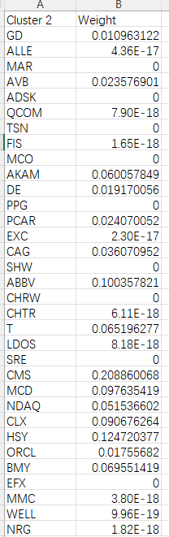
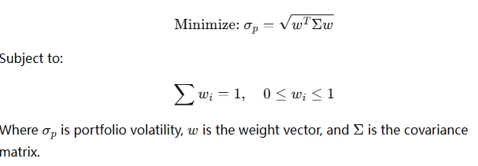
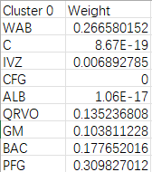
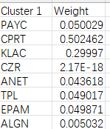
Portfolio Optimization
Mean-Variance Optimization (MVO): Aims to minimize risk or maximize returns.
Single-Cluster Optimization: Tailored weights calculated for each cluster.
Cross-Cluster Optimization: Explored but not used for final results.
Overall Portfolio Return: Combines individual cluster returns into one portfolio.

Slide 9
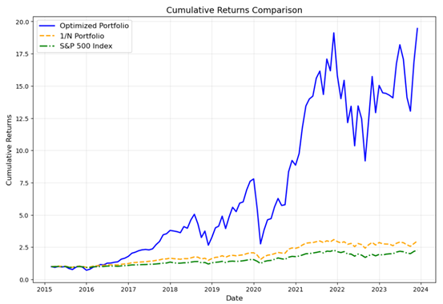
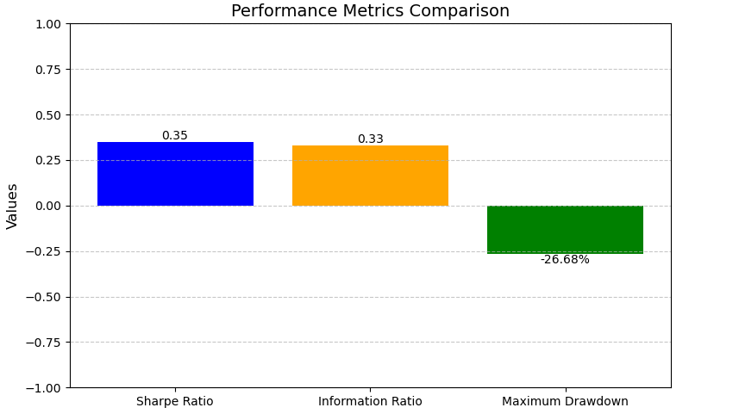
Performance Metrics
Sharpe Ratio: Risk-adjusted return indicator.
Information Ratio: Measures outperformance relative to benchmark.
Maximum Drawdown: Captures largest historical loss.
Optimized portfolio vs. 1/N Portfolio and S&P 500 Index.

Slide 10
Discussion and Conclusion
Key Achievements:
Integrated factor analysis, clustering, and optimization for portfolio construction.
Outperformed benchmarks like 1/N portfolio and S&P 500 in returns and risk-adjusted metrics.
Challenges and Limitations:
High cumulative returns (20x) might result from compounding a ~4% monthly return.
Static assumptions in mean-variance optimization can lead to amplified results over time.
Reliance on high-quality data and simplified risk models limits real-world applicability.
Addressing the 20x Issue:
Likely caused by compounding effects, static assumptions, or overfitting.
Future steps: Stress-testing, dynamic models, sensitivity analysis, and realistic transaction cost modeling.
Future Directions:
Dynamic time-varying models for evolving market conditions.
Extended factor models for deeper insights.
Machine learning techniques for further optimization.
Practical testing to ensure applicability in real-world scenarios.

Slide 11
References:
Fama, Eugene F., and Kenneth R. French. "Common Risk Factors in the Returns on Stocks and Bonds." Journal of Financial Economics, 33, (1993), pp. 3-56.
DeMiguel, Victor, Lorenzo Garlappi, and Raman Uppal. "Optimal versus Naive Diversification: How Inefficient is the 1/N Portfolio Strategy?" The Review of Financial Studies, 22, (2009), pp. 1915-1953.
Jagannathan, Ravi, and Ma, Tongshu. "Risk Reduction in Large Portfolios: Why Imposing the Wrong Constraints Helps." The Journal of Finance, 58, (2003), pp. 1651-1684.
Kenneth R. French - Data Library

